Slide 1


DART
A PERSONAL MEDICAL ASSISTANT

Slide 2



TABLE OF CONTENTS
About The Project
01
04
Methodology
Project Significance
02
05
App Features
03
06
Project Goals
Challenges/Way Forward
Abstract of MedAide
How the MedAide was developed?
Why MedAide is needed?
Propose to Implement/ Implemented
Objectives of MedAide
Constraints in development / Scope for improvement

Slide 3


ABOUT MedAide
MedAide is a Personal Medical Assistant App supporting speedy and efficient healthcare services.
It will expand the reach and the delivery mechanism of health related services

Slide 4




SIGNIFICANCE OF MedAide
Apps are easily accessible as 60% of the world’s population use smartphones
Gen Y and Gen Z prefer resolving issues through their smartphones
An online platform for fixing appointment and consultation with doctors is required :
for extending better health services for people living in rural and far-flung areas.
to reduce the Personal visits to hospitals especially during the pandemic
Helps to seek medical help in minimal time
Since some of the tasks can be done through app , it saves time and reduce the cost incurred
Need to have a track of medical history/medications for future consultations
Need to be more self sufficient in this turbulent scenario and hence one needs to monitor health personally

Slide 5
MedAide GOALS
FEATURES
POSITIONING
USER-CENTRIC
To incorporate features like searching nearby hospitals , fixing appointments , health record maintenance etc , so that this app will act as a personal medical assistant. Project also highlight the scope for improvements/ developments in the app.
Application to be compatible in mobile as mobiles are being used by almost everyone. Mobiles are easily/ quickly accessible and can be used at the point of care.
To develop a quickly accessible , user-friendly application which will help to prioritize health in our busy lives.

Slide 6

METHODOLOGY
FINALIZATION OF SCOPE / FEATURES CONSIDERING THE REQUIREMENT/CONSTRAINTS
CHOOSING DESIGN PATTERNS AND COLOUR PALETTES FOR EACH SCREEN
DEVELOPMENT OF APP USING FLUTTER
MODIFICATIONS TO SUIT THE LIMITATIONS
TESTING AND IMPLEMENTATION

Slide 7

FEATURES PROPOSED - MedAide
HEALTH AWARENESS: Educating users by sharing useful up-to-date health care information and motivational messages
DIAGNOSIS: Platform for the user to input the symptoms ; understand the possible health problem and seek appropriate medical help
SEARCH OPTION: Identify the nearby hospitals/clinics
PROFILE CREATION: One-time registration and creation of profile by users
SPEED DIAL: One –click emergency service

Slide 8
FEATURES PROPOSED - MedAide - contd..
HEALTH CARE SUGGESTIONS: On analysis based on tracking, identify the need to visit the doctor or suggest diets as a preventive measure
REMINDERS: Scheduling reminders for medicine
SCHEDULING APPOINTMENTS: Fixing of appointments in the selected hospital/clinic
TRACKING: Monitoring of users blood sugar levels, Blood pressure etc on input of blood /other relevant reports by the user
USER MEDICAL DATABASE: Storing personal details, medical history, reports, medications and other sensitive data

Slide 9

FEATURES IMPLEMENTED - MedAide
HEALTH AWARENESS
SEARCH OPTION
PROFILE
One –time registration and creation of profile by users .
SPEED DIAL
USER MEDICAL DATABASE
Motivate users to take care of their health through motivational / Inspirational messages
One-click emergency Service
Identify the Hospitals /Clinic based on the specialization sought
Storing of Medical Reports

Slide 10
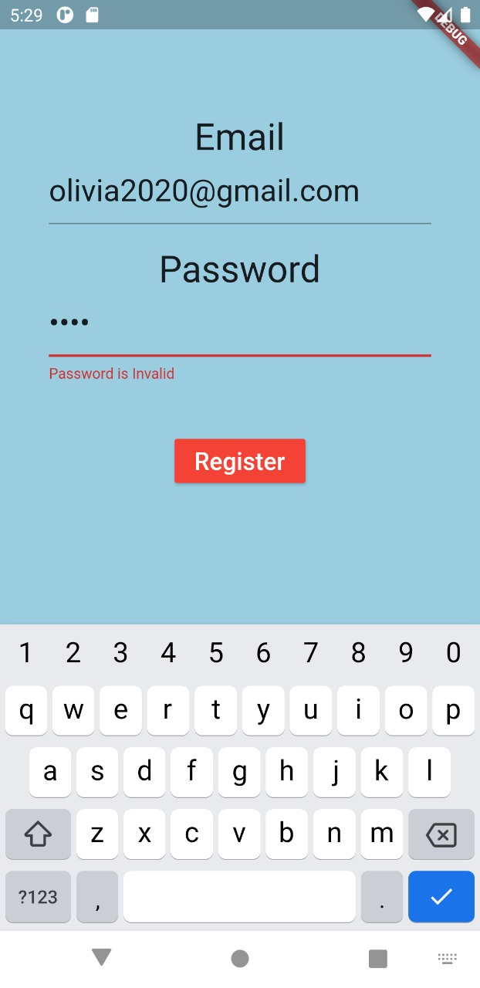
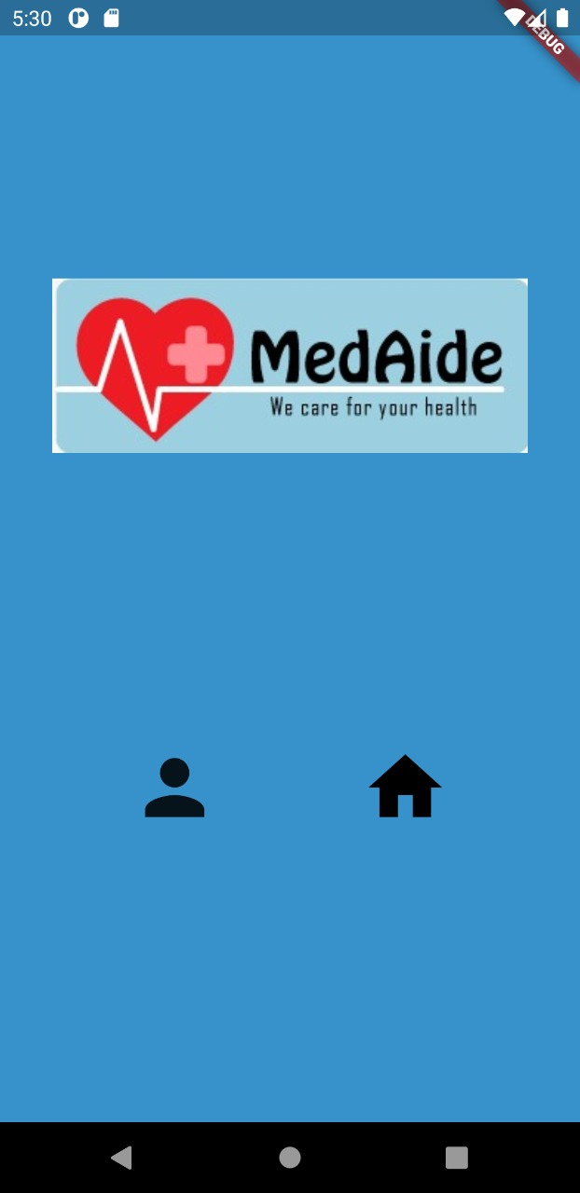
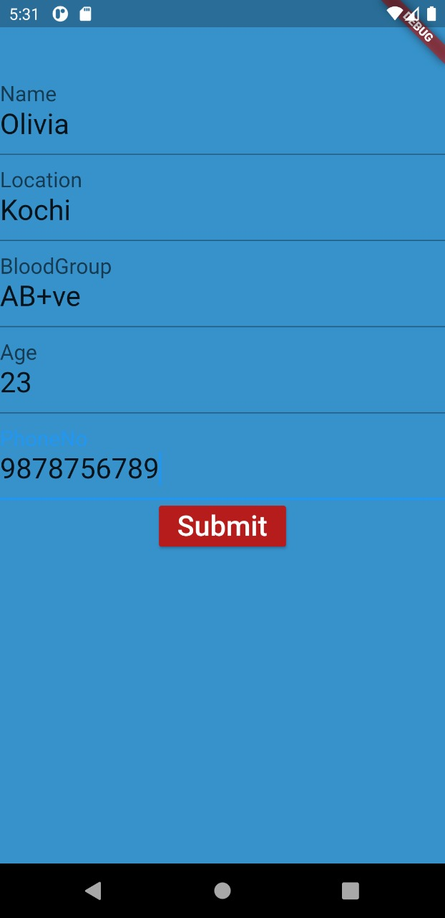
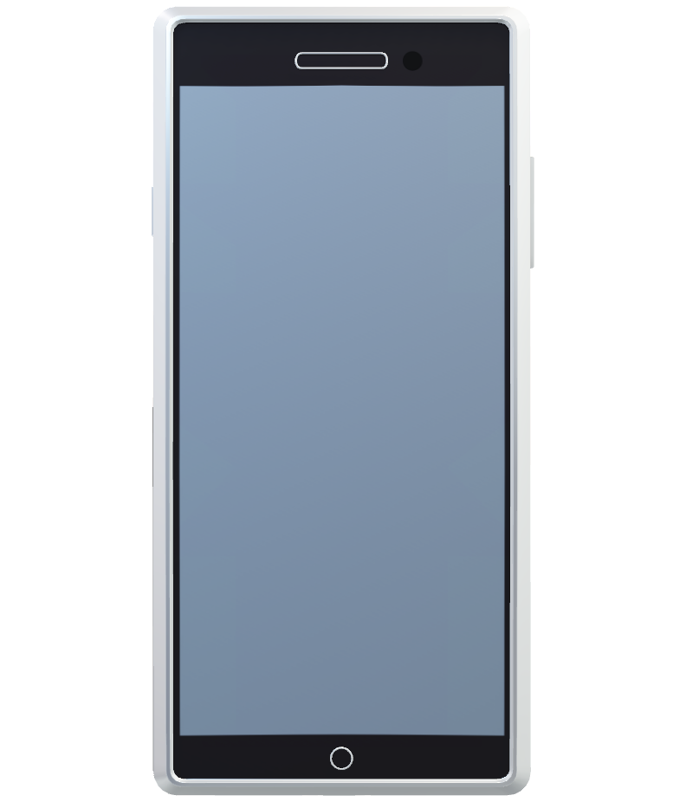
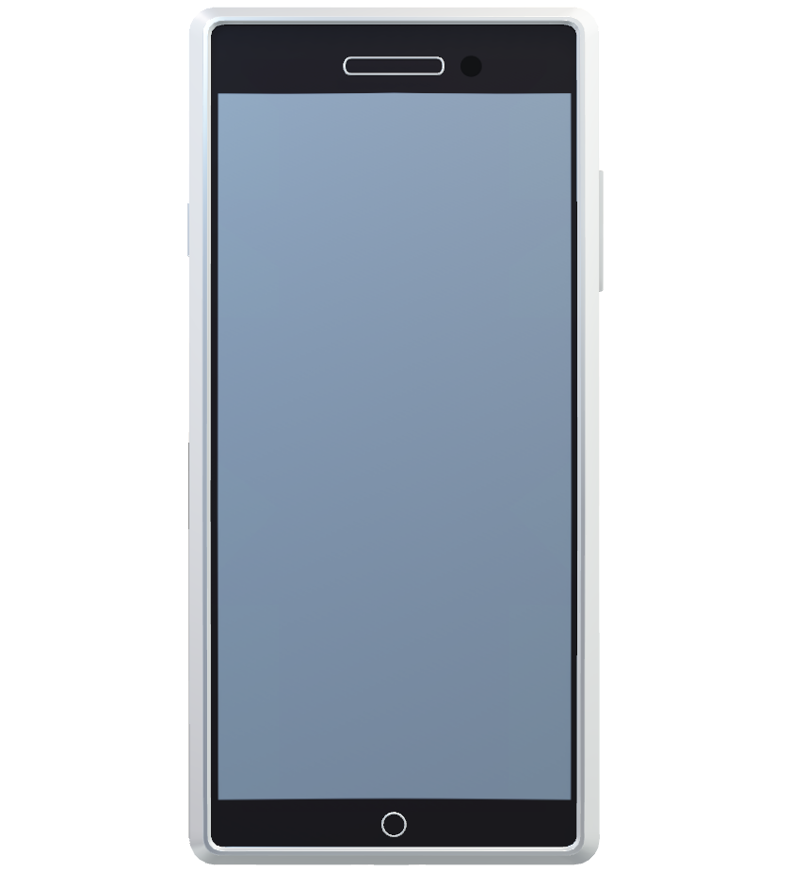

MedAide – SNAPSHOTS
Page for the Users to input their Profile Details
Initial screen visible to users after Login for the users to access Profile and Home Page by clicking on the respective icons
Login Screen

Slide 11
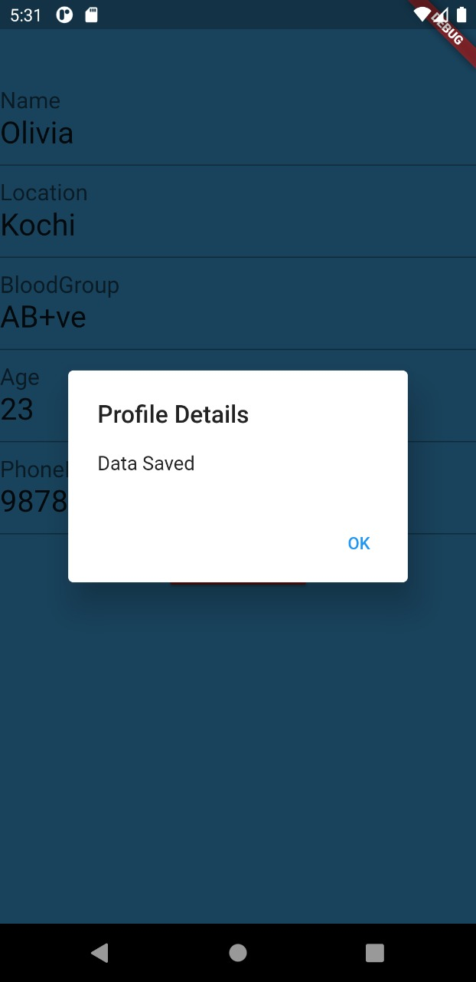
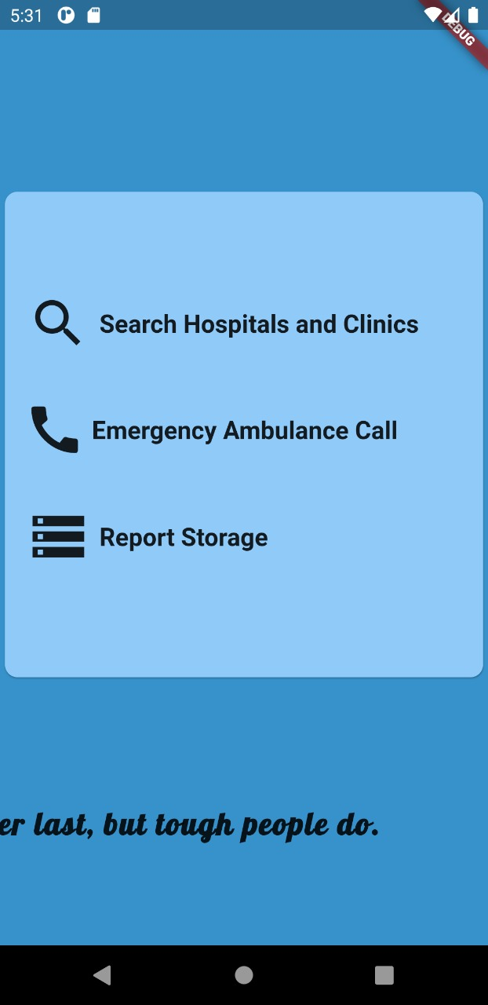
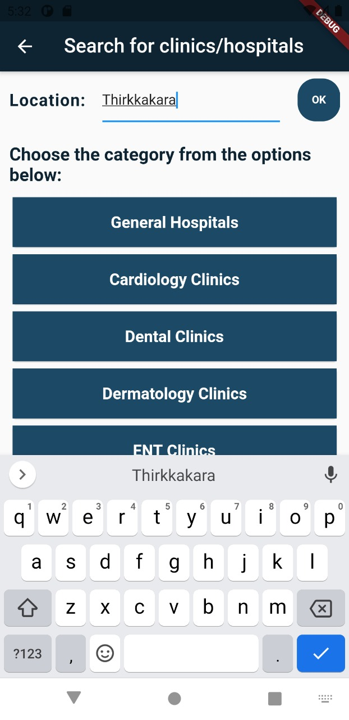
MedAide – SNAPSHOTS Contd..
On clicking the search option in Home Page user will be directed to this page. Here user can enter location and choose from the categories displayed.
Home page displaying the features accessible to users. Motivational / inspirational messages keeps scrolling below the page
Pop up message on screen confirming the saving of profile data

Slide 12
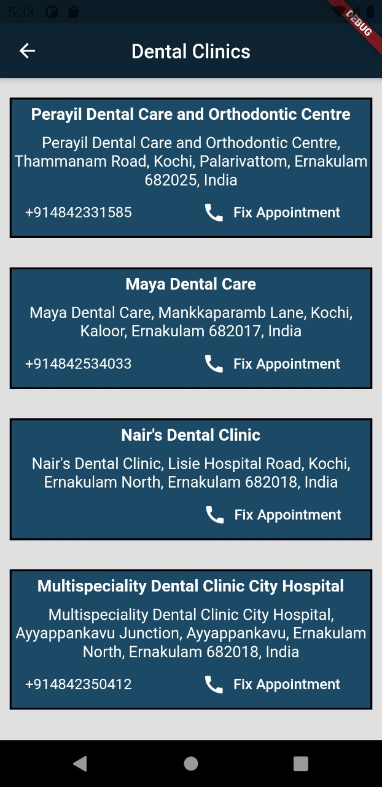
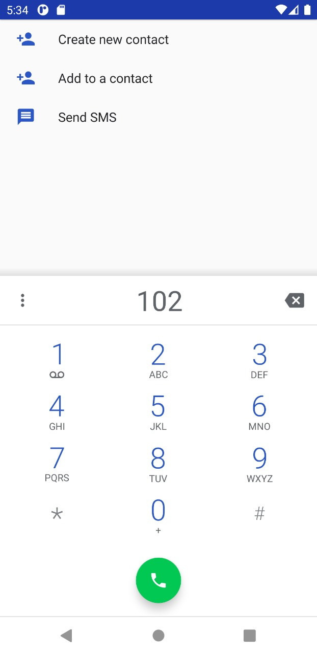
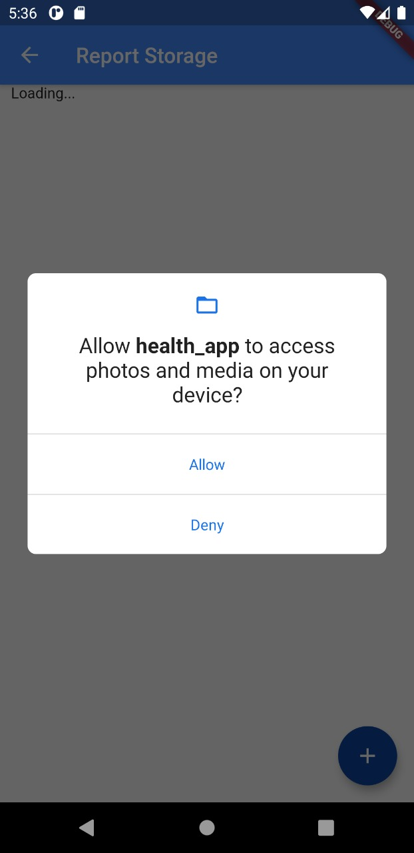
MedAide – SNAPSHOTS Contd..
On clicking the Report Storage option on Home Page for report upload first permission will be sought from the user as shown in this snapshot
If user selects the Speed Dial option on Home Page, this screen appears for the user with the default Emergency Contact no. 102
Once the location and specialisation is entered by User this Page will be displayed

Slide 13
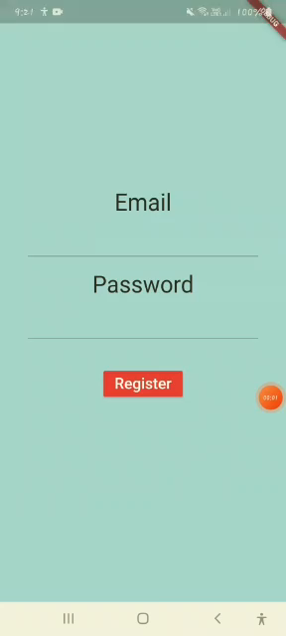

DEMO VIDEO OF MedAide

Slide 14
CHALLENGES
Team to be more proficient in Application Development
Time constraints
Effectiveness of team work hindered to some extent due to current pandemic situation

Slide 15

WAY FORWARD Scope for improvements in MedAide
REMINDERS
Scheduling reminders for doctor’s appointment, healthy habits like water intake etc
PURCHASE OF MEDICINES
Identify the Medical stores/labs nearby . Also facilitate online purchase.
CHATBOT
Chatbots can make the App more interactive and user-friendly
DOCTOR ON DEMAND
Remote healthcare services through online consultations
PAYMENT GATEWAY
REVIEWS AND RATINGS
NUTRITION
Suggest healthy recipes and diets
Integrate latest digital payment features (Wallets, credit/debit cards etc )for safe and convenient bill payments
Users can share Feedback/ experiences with respect to hospitals/clinics/medical shop etc.

Slide 16

TEAM - CODE HUNTERS
Jessica Jolly
Aneetta Mary Sajan
Diya Naushad
T Megha

Slide 17
THANK YOU

